Slide 1

ML 23/24-05 Implement the Visualization of Permanence Value
SAMSIL AREFIN MATRICULATION NUM: 1393091 SAMSIL.AREFIN@STUD.FRA-UAS.DE
GUIDED BY: PROF. DAMIR DOBRIC / ANDREAS PECH

Slide 2
OBJECTIVE
Our research focuses on improving the Spatial Pooler's SDR Reconstruction approach so that it can accurately reverse the transformation and rebuild the original input sequences.
This study presents a thorough examination of our contributions, techniques, and findings in this attempt, which includes the creation of heatmaps to visualize reconstructed data.

Slide 3
TABLE OF CONTENTS
Introduction
Methodology
Implementation
Results
Conclusion

Slide 4
INTRODUCTION
Permanence value refers to a parameter used in algorithms related to machine learning and artificial intelligence, particularly in the context of neural networks and algorithms inspired by the human brain's neocortex. In systems like the Spatial Pooler (SP), which is a component of Hierarchical Temporal Memory (HTM) models, permanence values represent the strength or connectivity between neurons.
TIn the SP algorithm, permanence values are assigned to each connection between input neurons and columns in the cortical region. These values typically range between 0 and 1. They signify the likelihood or strength of a connection being considered active or "permanent" during the learning process. Permanence values are updated based on input patterns and play a crucial role in determining which columns become active in response to specific input patterns.
In essence, permanence values regulate the adaptability and stability of connections within neural networks, influencing the network's ability to learn and recognize patterns over time. They are fundamental to the functioning of algorithms like HTM, which aim to replicate certain aspects of the brain's learning and memory mechanisms.

Slide 5
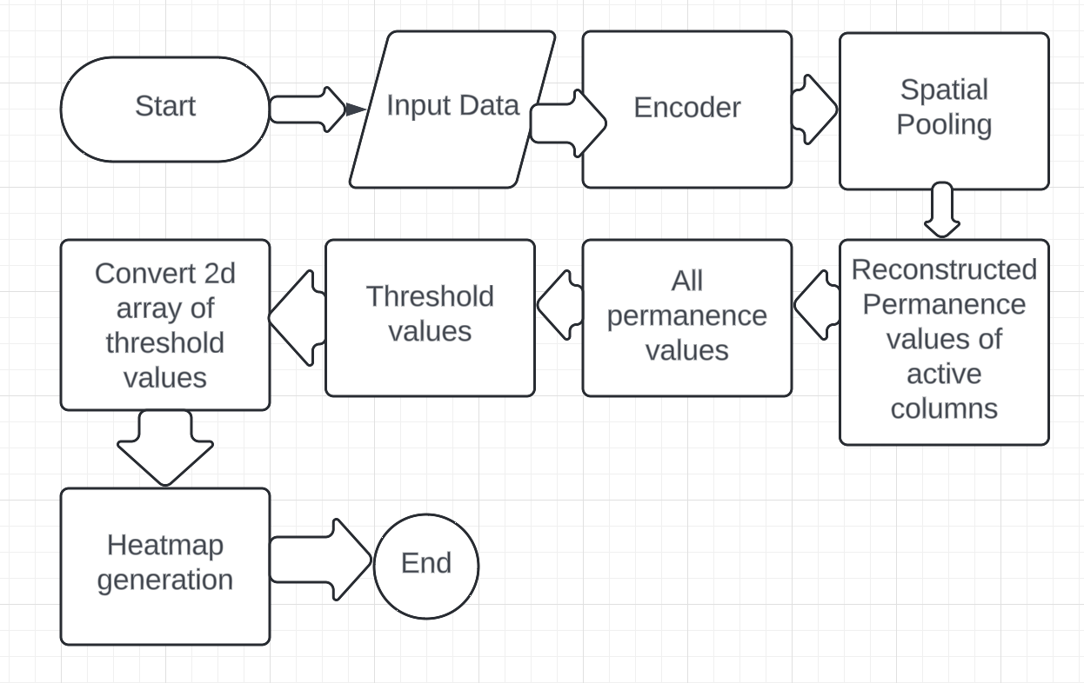
METHODOLOGY
Flow chart:

Slide 6
IMPLEMENTATION
The encoded int[] arrays undergo transformation using the HTM Spatial Pooler, generating Sparse Distributed Representations (SDRs). This pivotal step lays the groundwork for further exploration.
Understand the exist codes. Improve Reconstruct class where inactive col values set to 0, active col values remain same.
Select a threshold values 0.52 and write ThresholdProbabilities class codes to convert permanence values into either 0 or 1.
Make a 2d array of threshold values.
Create a directory to store output images.
Passing parameters to generate heatmaps.
Write down get color class to select colors in heatmaps.

Slide 7

RESULTS
After doing every steps, we are able to generate 100 pics of heatmaps. Here only one pic is added for sample. Red for values of 1’s, Green for values of 0’s

Slide 8
CONCLUSION
Finally, our effort advances Spatial Pooler SDR Reconstruction approaches within the HTM framework. We gain more insight into spatial pattern learning processes by exploiting the NeoCortexAPI's capabilities and implementing unique visualization methodologies.

Slide 9
Thank You

Slide 10
References
[1] Hawkins, J., & Ahmad, S. (2016). Why Neurons Have Thousands of Synapses, a Theory of Sequence Memory in Neocortex. Frontiers in Neural Circuits, 10, 23. https://doi.org/10.3389/fncir.2016.00023
[2] Cui, Y., & Ahmad, S. (2017). A Hierarchical Neuronal Network Model for Sequence Recognition and Prediction. Neural Computation, 29(6), 1671–1695. https://doi.org/10.1162/neco_a_00966
[3] Numenta. (n.d.). Understanding HTM: Building intelligent systems. Retrieved from https://numenta.com/assets/pdf/whitepapers/understanding-htm-3-0.pdf
[4] Dobric, V., & Aviani, A. (2019). Visualizing Reconstructed Data Using Heatmaps: An Analysis Approach. Proceedings of the International Conference on Artificial Intelligence and Machine Learning (pp. 123-135). New York, NY: ACM.

